Slide 1
Advanced Database Topics
Dave Valentine
dkValz@comcast.net
www.ingenioussql.com

Slide 2
Agenda
System Catalog Views
Dynamic Management Views
Extended Events
Index Maintenance
Database Partitioning
AWS and AZURE Databases
Performance Tuning

Slide 3
About Dave
MCP
MCSA: SQL Server 2012
Database Architect / Database Developer
Adjunct Professor
@IngeniousSQL
dkValz@comcast.net
IngeniousSQL.com

Slide 4
System Catalog View (Objects)
Catalog of metadata that describes database structures
Database discovery
Schema comparison
Development and deployment
Common Object Catalog Views
sys.objects
sys.tables
sys.columns
sys.procedures
sys.indexes
https://docs.microsoft.com/en-us/sql/relational-databases/system-catalog-views/catalog-views-transact-sql
https://docs.microsoft.com/en-us/sql/relational-databases/system-catalog-views/object-catalog-views-transact-sq

Slide 5
Dynamic Management View
Dynamic management views and functions return server state information that can be used to monitor the health of a server instance, diagnose problems, and tune performance.
Dynamic Management View Grouping
sys.dm_exec… Execution and Connection Information
sys.dm_os… Operating System Information
sys.dm_tran… Transaction Information
sys.dm_db… Database Information
sys.dm_xe… Extended Event Information
Useful DMV’s
sys.dm_exec_cached_plans Cached Query Plans
sys.dm_exec_sql_text Gets the SQL Query Text
sys.dm_exec_query_plan Gets Query Plans
sys.dm_exec_sessions Active Sessions in SQL Server
sys.dm_db_index_usage_stats Index Details
https://docs.microsoft.com/en-us/sql/relational-databases/system-dynamic-management-views/system-dynamic-management-views

Slide 6
Cached Query Plans DMV
Returns a row for each query plan that is cached by SQL Server for faster query execution. You can use this dynamic management view to find cached query plans, cached query text, the amount of memory taken by cached plans, and the reuse count of the cached plans.
select * from sys.dm_exec_cached_plans
https://docs.microsoft.com/en-us/sql/relational-databases/system-dynamic-management-views/sys-dm-exec-cached-plans-transact-sql

Slide 7
SQL Query Text DMF
Returns the text of the SQL batch that is identified by the specified sql_handle/plan handle.
The sql_handle can be obtained from dynamic management objects such as :
sys.dm_exec_query_stats
sys.dm_exec_connections
The plan_handle can be obtained from dynamic management objects:
sys.dm_exec_cached_plans
sys.dm_exec_procedure_stats
sys.dm_exec_trigger_stats
select * from sys.dm_exec_sql_text(0x06000600570C3715B0FCDF49080000000100000…
https://docs.microsoft.com/en-us/sql/relational-databases/system-dynamic-management-views/sys-dm-exec-sql-text-transact-sql

Slide 8
SQL Profiler
Deprecated Feature
Performance
Client vs Server Side
Extended Events
https://docs.microsoft.com/en-us/sql/tools/sql-server-profiler/sql-server-profiler

Slide 9
Extended Events
Light weight monitoring system that uses very few system recourses
Evolving Tool
Windows Events
SQL Server Events
Templates
Events
Event Fields
Target Types (Data Storage)
Ring Buffer
Event File
Others (Histogram, Event Counter, Pair Matching)
https://docs.microsoft.com/en-us/sql/relational-databases/extended-events/extended-events
https://docs.microsoft.com/en-us/sql/relational-databases/extended-events/quick-start-extended-events-in-sql-server

Slide 10
Indexing
Heaps
Indexes
CLUSTERED
Physical order of a table
NONCLUSTERED
Another order of the table with specified columns
Covering
Including all columns needed to satisfy a query
Filtered
Includes data that meets a specified predicate

Slide 11
Indexing Continued
Index Types
XML
Indexes specifically for XML columns
Clustered Index must be defined
Primary Index – Stores all node values, types and paths
Similar to Clustered Index
Large Index
Secondary Index
Primary XML Index has to be defined
Path – the structure
Value – the values
Property – Includes base table’s primary key, path, and values.

Slide 12
Indexing Continued
Index Types
Column Store
Converts the traditional row based storage into column segments
Smaller Footprint
Not Updateable in 2012
Clustered Columns Store Updatable in 2014
Non-Clustered Updateable in SQL Server 2016

Slide 13
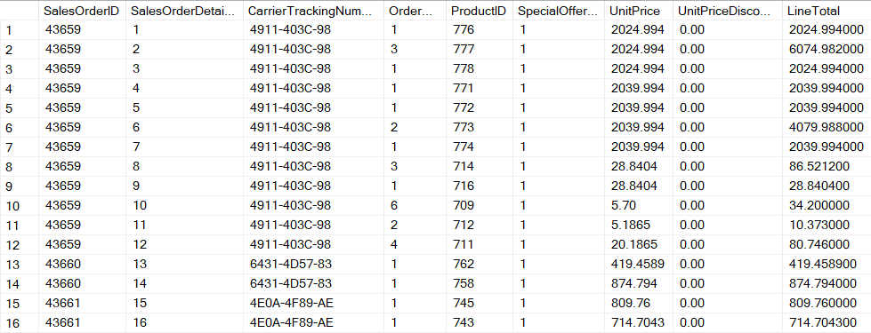
Row Based Index
Column Store
8K Page
8K Page

Slide 14
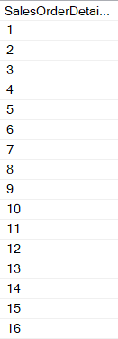
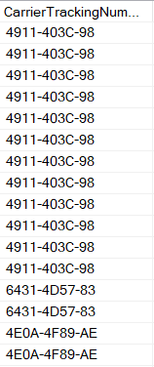
Column Store Index
Column Store
Segments
8K Page
8K Page
8K Page
8K Page

Slide 15
Indexing Maintenance
When to add update remove index
Performance implications
Index DMV’s
dm_db_index_usage_stats
dm_db_missing_index_details
dm_db_missing_index_groups
dm_db_missing_index_group_stats
Brent Ozar’s Index Blitz
https://www.brentozar.com/blitzindex/

Slide 16
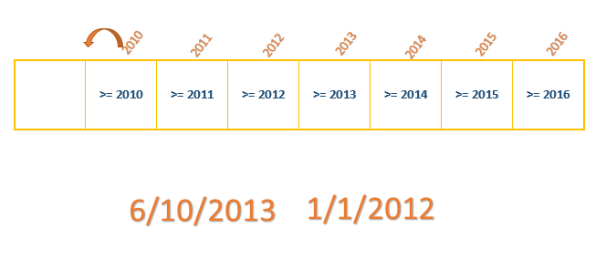
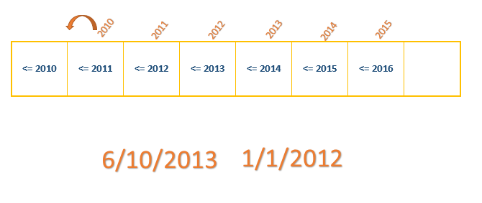
Database Partitioning
Performance
Partition function
Single Column
Data type
Range Right or Left (inclusive)
Range Right suggested for dates
File Groups
Database Files
Partition Scheme
maps data from table to the file groups via partition function
Order of file groups specify where data is loaded
Create or alter table (on partition scheme)

Slide 17
Database Partitioning
Switch in
Identical Schemas
Additional Constraints Required
Existing Constraints must be implemented

Slide 18
IaaS Databases
Infrastructure as a Service
Similar to Virtual Machines
Provider Manages Hardware
Operating System
Existing Application Development
Pros
Full Control
Cloud Computing Benefits
Customization
Integration with existing infrastructure
Cons
BYOL (Bring Your Own License)
Total Cost of Ownership
Manage Server
SQL Server Installation

Slide 19
PaaS Databases
Platform as a Service
Provider Manages Hardware
Provider Manages Operating System
Provider Manages Database Server Internals
New App development
Pros
SQL Server License included in Cost
Scaling Up and Down
Less IT Support, DBA’s
Application Development Speed
Cons
Control
Cost
Functionality
Configuration

Slide 20
Azure SQL Databases
Microsoft Technology
DTU (Data Transaction Unit)
CPU, Memory, Reads, Writes
https://azure.microsoft.com/en-us/pricing/calculator/
Elastic Queries
Authentication
SSIS, MDS, DQS
Separate Database Connections
Troubleshooting and Server Level DMVs
Network IP Ranges
Elastic Database Jobs

Slide 21
AWS RDS Database
Amazon Web Service Technology
Size Based Pricing Model
https://aws.amazon.com/rds/sqlserver/pricing/
Authentication
RDS Server Based
SSAS, SSIS, DQS, MDS
Limitation Number of Database
Troubleshooting and Server Level DMVs
SQL Agent

Slide 22
Summary
System Catalog Views
Dynamic Management Views
Extended Events
Deadlocks
Indexing
Index Utilization
Database Partitioning
SWITCH IN
AWS and AZURE Databases

Slide 23
Questions
Dave Valentine
@ingeniousSQL
ingeniousSQL.com
linkedin.com/in/ingenioussql

