Slide 1
RULES OF ENGAGEMENT:
NOSQL IS SQL SERVER’S ALLY
RICK KRUEGER
DAVE VALENTINE
@dataogre
dataogre.com
linkedin.com/in/premierapps
@ingeniousSQL
ingeniousSQL.com
linkedin.com/in/ingenioussql

Slide 2
Why Rules of Engagement?
“Directives issued by competent military authority that delineate the circumstances and limitations under which United States forces will initiate and/or continue combat engagement with other forces encountered” - http://ra.defense.gov (JP-104)

Slide 3
Why Rules of Engagement?
“Directives issued by competent military authority that delineate the circumstances and limitations under which United States forces will initiate and/or continue combat engagement with other forces encountered” - http://ra.defense.gov (JP-104)

Slide 4
Why Rules of Engagement?
“Directives issued by competent military authority that Delineate the circumstances and limitations under which United States forces will initiate and/or continue combat engagement with other forces encountered” - http://ra.defense.gov (JP-104)

Slide 5
Why Rules of Engagement?
“Directives issued by competent military authority that delineate the circumstances and limitations under which United States forces will initiate and/or continue Combat engagement with other forces encountered” - http://ra.defense.gov (JP-104)

Slide 6
AGENDA
NoSQL Family
  Key Value
  Column Store
  Document Databases
  Graph Databases
Polyglot Persistence
Eventual Consistency
Wrap Up
Questions & Answers

Slide 7
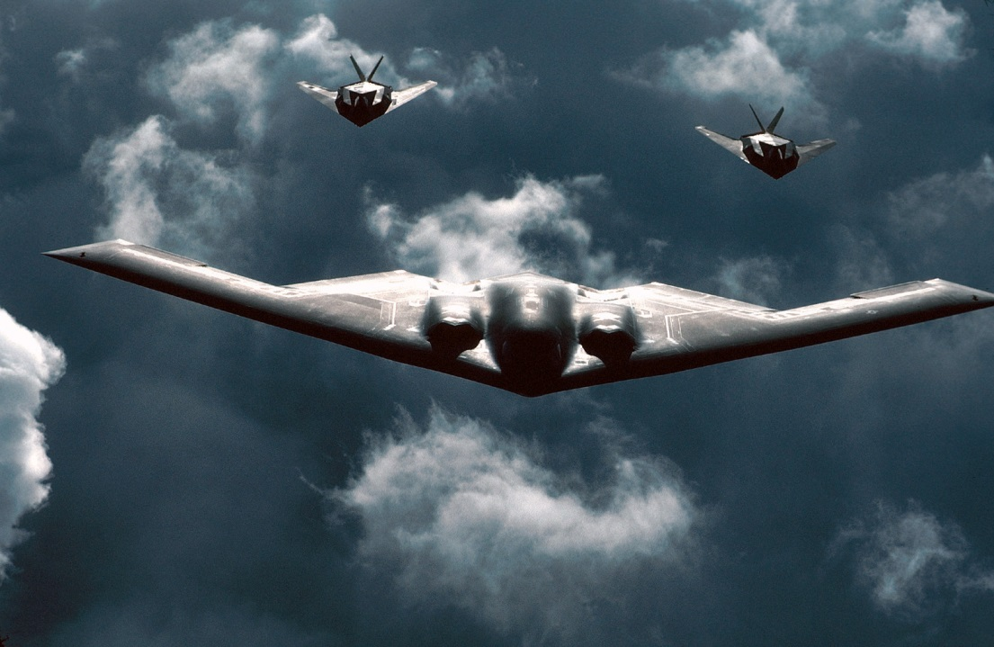
Key Value
Simple
123
My Car
124
C-4140-9564-5B282
U.S. Air Force photo

Slide 8
Key Value
Simple
Fast
123
My Car
124
C-4140-9564-5B282
U.S. Air Force photo

Slide 9
Key Value
Simple
Fast
Scalable
123
My Car
124
C-4140-9564-5B282
U.S. Air Force photo

Slide 10
Key Value
Simple
Fast
Scalable
Cheap
123
My Car
124
C-4140-9564-5B282
U.S. Air Force photo

Slide 11
Key Value
Simple
Fast
Scalable
Cheap
Key Structure
123
My Car
124
C-4140-9564-5B282
U.S. Air Force photo

Slide 12
We have to wait how long?

Slide 13
Key Value
Couchbase
  Adidas, ADP, BMW
  Linux, Windows, OS X
  http://www.couchbase.com/
Riak
  Yammer, Best Buy, Github
  Linux, OS X
  http://basho.com/riak/
Redis
  Twitter, Craigslist, flickr
  Linux, OS X
  http://redis.io/

Slide 14
Key Value – When to use
Keys value pairs
Web Components
Device Check-in

Slide 15
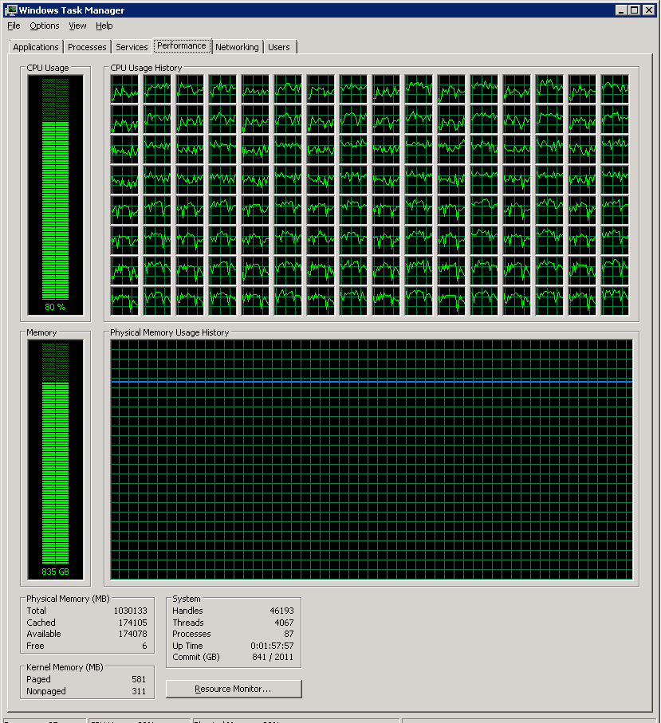
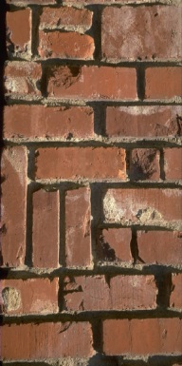
Key Value: The Need For Speed
BEFORE
AFTER
100K
100K
Cache

Slide 16
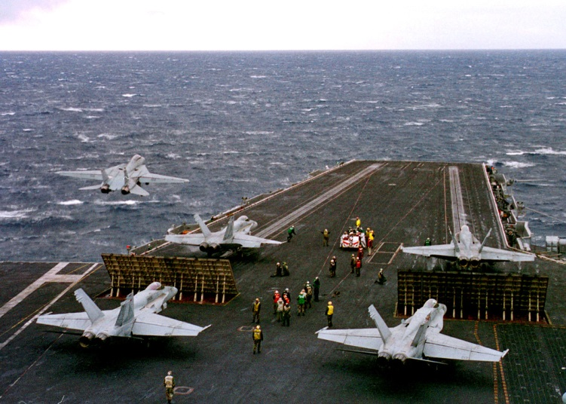
Column Stores
DoD photo by Petty Officer 1st Class Benjamin D. Olvey, U.S. Navy. (Released)

Slide 17
Column Stores
Person_Details
Car_Details
123455
Name: Jen
Insurance: St Farm
Car: 626
Year: 2008
123456
Name: Bob
123457
Name: John
Insurance: Geico
Car: Speed 3
Year: 2013
Warranty: Yes
10
Type: Oil
11
Type: Tires
12
Type: Wipers
ID | Name | Insurance | Car | Year | Warranty
123455 | Jen | St Farm | 626 | 2008 | NULL
12356 | Bob
12357 | John | Geico | Speed 3 | 2013 | Yes
ID | Type | CarID
10 | Oil | 12357
11 | Tires | 12357
12 | Wipers | 12357

Slide 18
Column Stores
Scalable
Simple is Fast
Column Aggregation
Complex = Map Reduce
Complex can be Slow
DoD photo by Petty Officer 1st Class Benjamin D. Olvey, U.S. Navy. (Released)

Slide 19
Column Stores
Scalable
Simple is Fast
Column Aggregation
Complex = Map Reduce
Complex can be Slow
DoD photo by Petty Officer 1st Class Benjamin D. Olvey, U.S. Navy. (Released)

Slide 20
Column Stores
Scalable
Simple is Fast
Column Aggregation
Complex = Map Reduce
Complex can be Slow
DoD photo by Petty Officer 1st Class Benjamin D. Olvey, U.S. Navy. (Released)

Slide 21
Column Stores
Scalable
Simple is Fast
Column Aggregation
Complex = Map Reduce
Complex can be Slow
DoD photo by Petty Officer 1st Class Benjamin D. Olvey, U.S. Navy. (Released)

Slide 22
Column Stores
Scalable
Simple is Fast
Column Aggregation
Complex = Map Reduce
Complex can be Slow
DoD photo by Petty Officer 1st Class Benjamin D. Olvey, U.S. Navy. (Released)

Slide 23

Column Stores
HBase
  eBay, BlackBerry, Expedia
  Linux, OS X, Windows **
  http://hbase.apache.org/
Cassandra
  Facebook, Shazam, Twitter
  Linux, OS X, Windows
  http://cassandra.apache.org/
** Additional software is required
HD Insight

Slide 24
Column Stores: Do I need it…
Unstable Schema
Nullable Columns
Collections
http://www.youtube.com/watch?v=7hfpQMu5xJ0

Slide 25







Document Databases
"That's so crazy that it just might work!"

Slide 26
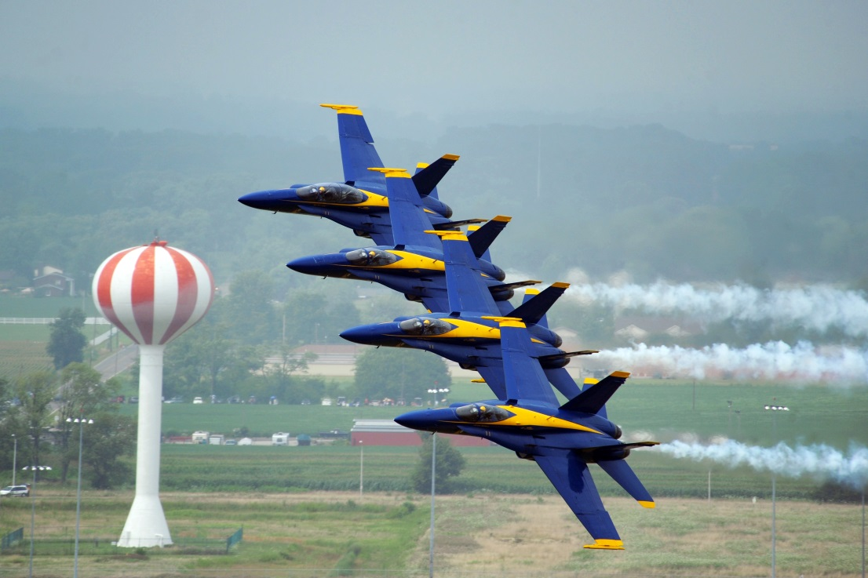

Document Databases: Planning
http://www.blueangels.navy.mil/

Slide 27
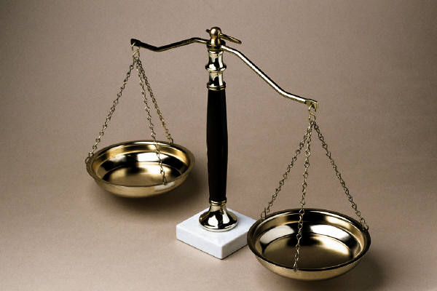
Document Databases: Schemaless?

Slide 28
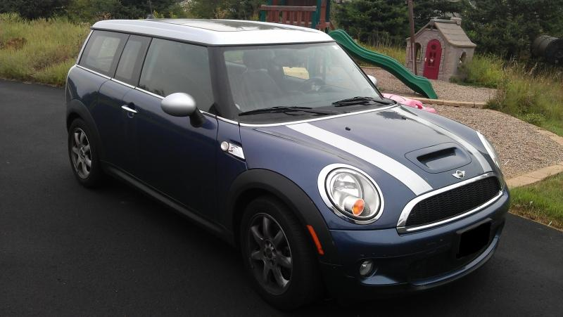
Document Databases: Not Relational
Models Table
1790 | Clubman
1791 | Countryman
1792 | Coupe
1793 | Roadster
Trims Table
411 | 1790 | Base | 118
412 | 1790 | John Cooper Works | 208
413 | 1790 | S | 172
414 | 1791 | Base | 121

Slide 29
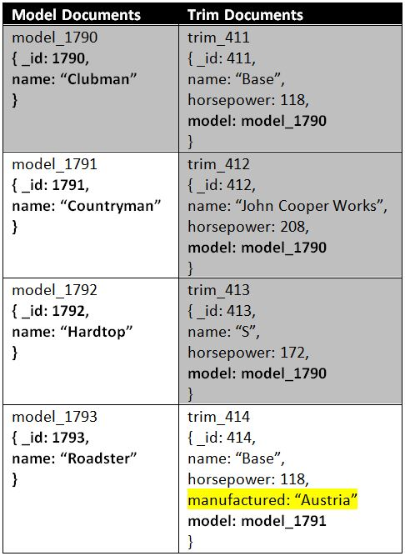
Document Databases: Normalized
JSON: JavaScript Object Notation

Slide 30
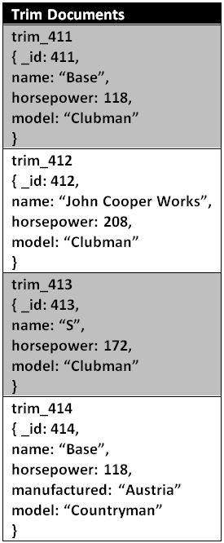
Document Databases: Denormalized

Slide 31

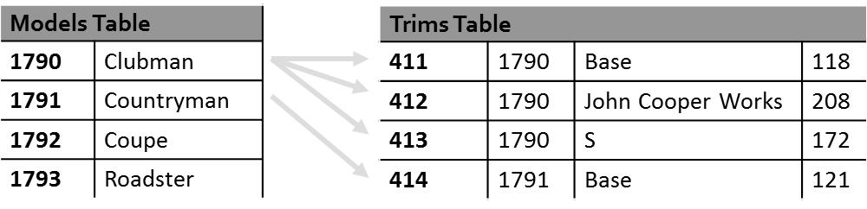
Document Databases: Natural

Slide 32
Document Databases: Options
mongoDB
  Craigslist, Foursquare, Shutterfly, Intuit
  Windows, Linux, and OS X
  http://www.mongodb.org/
CouchDB (CouchBase)
  HootSuite, Vimeo
  Windows, Linux, and OS X
  http://couchdb.apache.org/
RavenDB
  MSNBC.COM, JetBrains
  Windows and Linux
  http://ravendb.net/

Slide 33
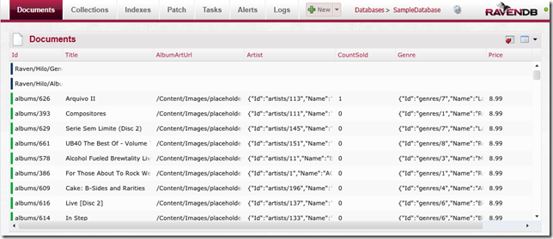
Document Databases
RavenDB Management Studio

Slide 34
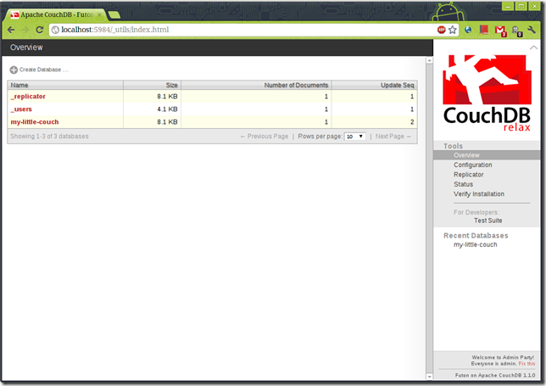
Document Databases
CouchDB Futon

Slide 35
You Might Need A Document Database
…if your application is document based (eg Content Management, Blogging, User Data Management), or the data isn’t tabular or structured
…if you want to archive data, and do not want to deal with schema changes in the archived table
…if you are looking for an easier upgrade path or have constant schema churn
…if you find yourself using SQL antipatterns, like EAV (Entity-attribute-value)
…if programmer friendliness is a big concern

Slide 36

Graph Databases
Relationships
Nodes
Properties
Edges
Records
Data
PK / FK
1: (Name: Rick, DOB:20120505)
OWNS:
(VIN: 12BA126)
DoD photo by Staff Sgt. Samuel Bendet
U.S. Air Force (Released)
2: (Make: Mini, Model: Clubman)

Slide 37
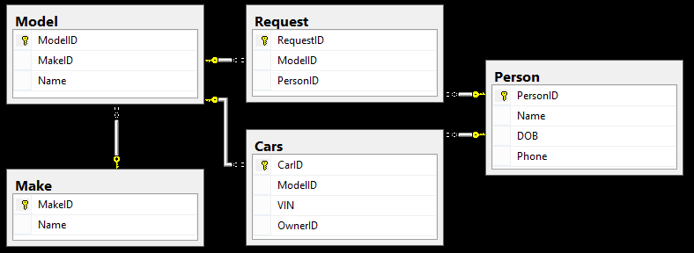
Graph Databases

Slide 38
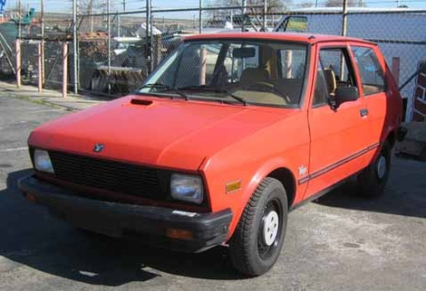
Graph Databases
http://jalopnik.com/365474/how-about-a-yugo-for-the-24-hours-of-lemons
9 | Bob
3 | Mini
5 | Glen
Wants
Wants
11 | Nick
12 | Neon
Owns
Owns
Owns
Owns
1 | Rick
13 | A6
7 | Brandon
6 | 626
Owns
Wants
Wants
Wants
Wants
Owns
Wants
10 | M4
4 | Yugo
2 | Dave
8 | S4
Owns

Slide 39

Graph Databases
https://www.facebook.com/about/graphsearch

Slide 40
Graph Databases
Neo4j
  Adobe, Cisco, T-Mobile
  Linux, OS X, Windows
  http://www.neo4j.org/
AllegroGraph
  NASA, Kodak, Pfizer
  Linux, OS X, Windows
  http://www.franz.com/agraph/allegrograph/
InfiniteGraph
  CIA, DOD
  Linux, OS X, Windows
  http://www.objectivity.com/infinitegraph

Slide 41
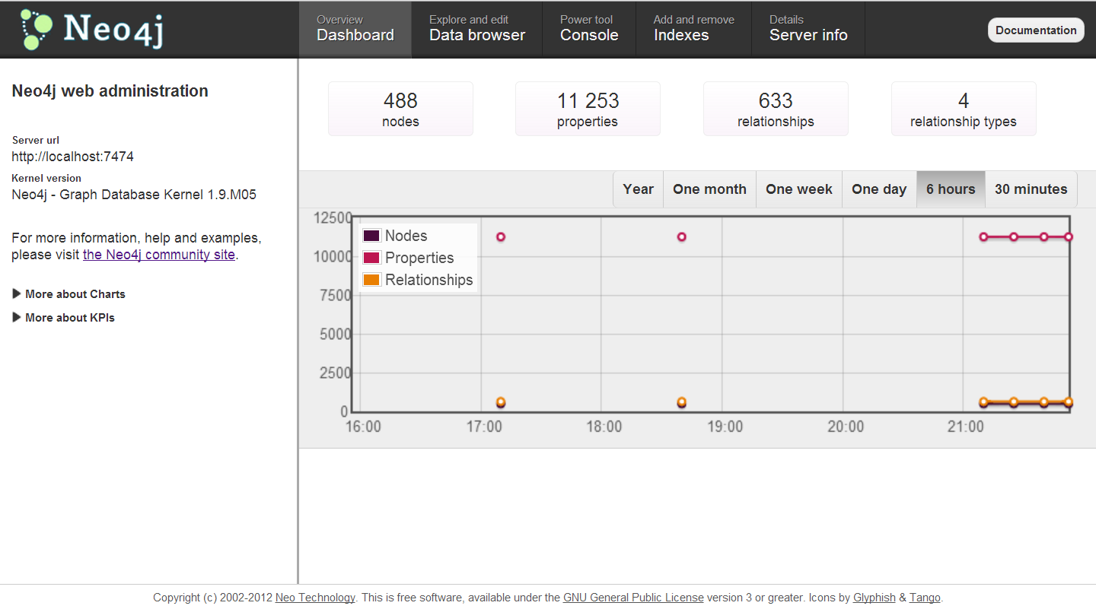
Graph Databases

Slide 42
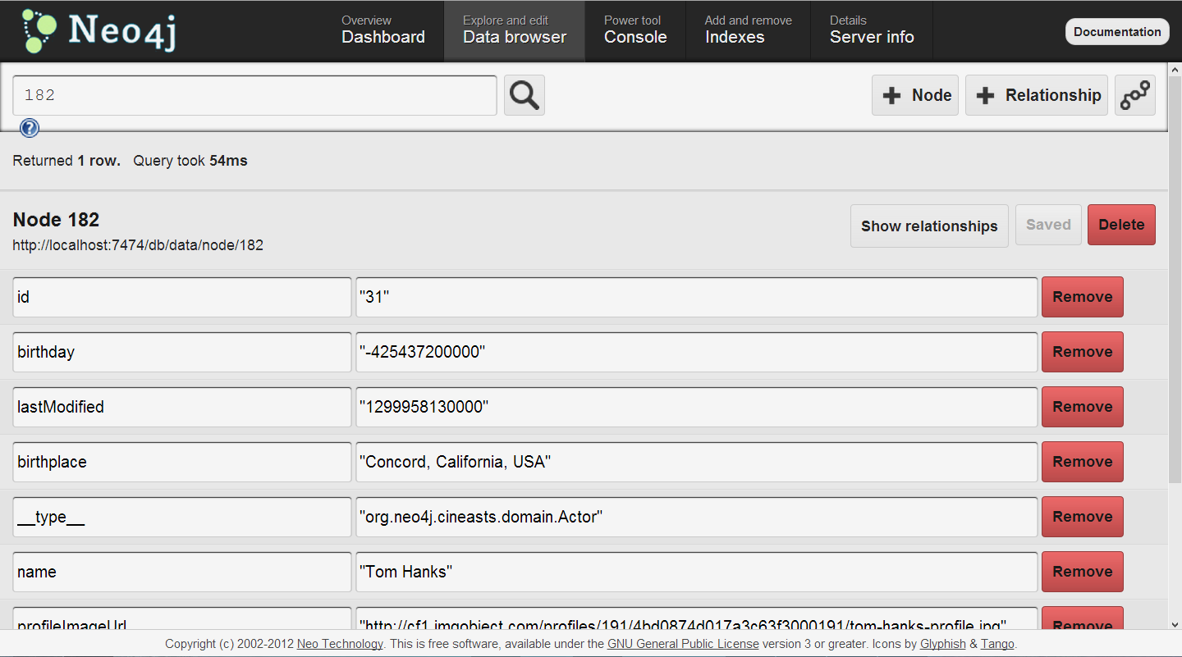
Graph Databases

Slide 43
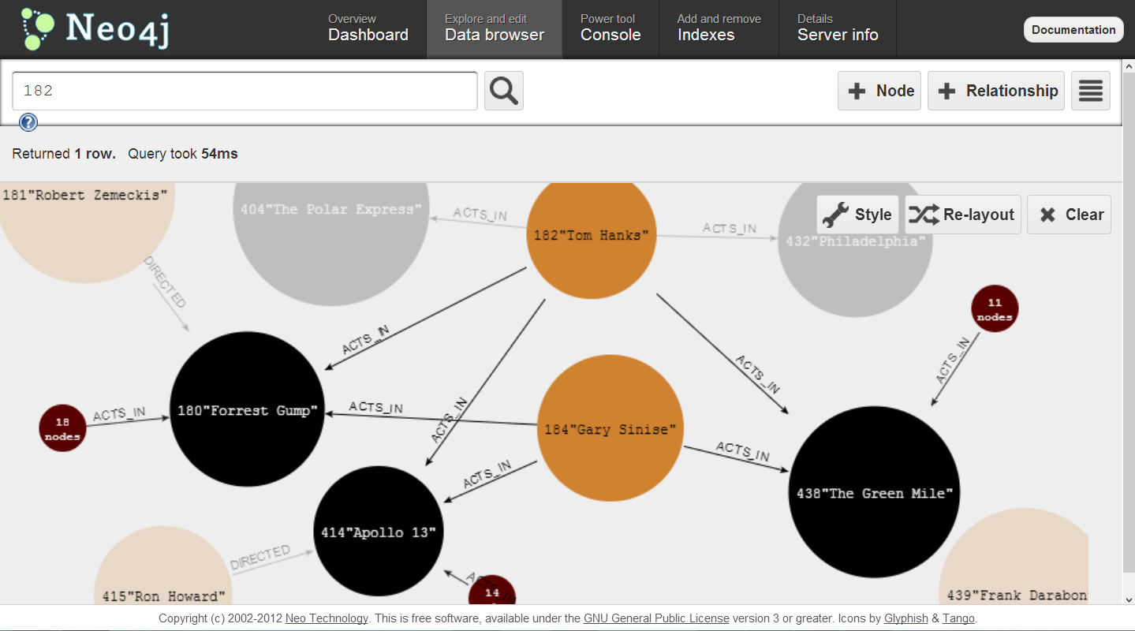
Graph Databases

Slide 44
Graph Databases – When to use…
Network
Relationships
Geo

Slide 45

Polyglot Persistence
"This is space! Course, we’re just in the beginning part of space, we-we haven’t even got to *outer* space yet!“
– Armageddon (1998)

Slide 46
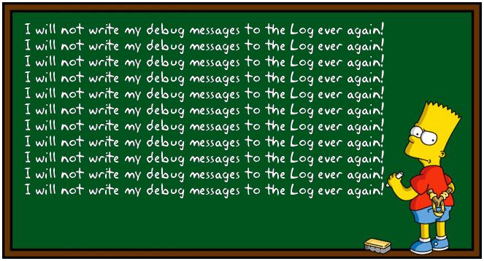
Polyglot Persistence: Write-Only

Slide 47
Polyglot Persistence: Write Only
Graph Database?
Key Value?
Column Store?
Document Database?

Slide 48

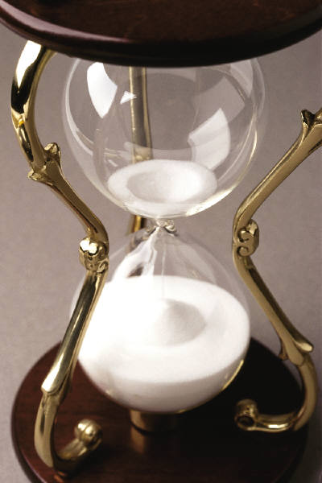
Polyglot Persistence: Schema Upgrade

Slide 49

Polyglot Persistence: Archiving

Slide 50
Polyglot Persistence: Cache
OLTP
Warehouse
Nightly
Nightly
Other Data

Slide 51
Polyglot Persistence: Cache
Version 1
Warehouse
Other Data
Version 2
Version 3

Slide 52

Polyglot Persistence: 1000 Words

Slide 53

Consistency

Slide 54
Consistency: We want it ALL
Speed
Availability
Scale
Consistency
Latency

Slide 55
Consistency: Definitions
N – the number of Nodes (or replicas) that store the data
W – the minimum number of nodes that must acknowledge the Write before considered complete
R – the minimum number of Read nodes (or replicas) queried for a read operation

Slide 56
Consistency: Distributed
Replica 1
Replica 2
Replica 3

Slide 57

Consistency: Strong
W = 2
N = 2
R = 1
W+R > N == Strong Consistency

Slide 58
Consistency: Strong
W = 1
N = 2
R = 2
W+R > N == Strong Consistency

Slide 59
Consistency: Weak
W = 1
N = 2
R = 1
W+R <= N == Weak Consistency

Slide 60

Consistency: SQL Scale Out
Active Secondaries: Readable Secondary Replicas
“In many circumstances, data latency between a primary database and the corresponding secondary database is only a few seconds.” -http://msdn.microsoft.com/en-us/library/ff878253.aspx
 | Consistency |  | Latency
 | Strong | Weak | Low | High
Synchronous Replication
High Safety Mirroring
Synchronous AlwaysOn Availability Group
Asynchronous Replication
High Performance Mirroring
Asynchronous AlwaysOn Availability Group

Slide 61
Consistency: Cost
Google search result count = 30 resulted in 20% loss
Amazon, 100ms delays perceptible to users
Speed matters!

Slide 62
Rules of Engagement
RDBMS
Graph
Data Complexity
Document Database
90% of Data
Column Store
Key Value
Data Size / Scalability

Slide 63
Remember
Pick the store that matches the shape of your data
Don’t use SQL Server to build Rube Goldberg Machines
If anyone thinks that NoSQL means no planning, they couldn’t be more wrong
Stay informed: NoSQLWeekly.com

Slide 64
Questions?
RICK KRUEGER
DAVE VALENTINE
@dataogre
dataogre.com
linkedin.com/in/premierapps
@ingeniousSQL
ingeniousSQL.com
linkedin.com/in/ingenioussql

