Slide 1
SSRS: Reporting on Reports
Rick Krueger (@DataOgre)
Dave Valentine (@IngeniousSQL)

Slide 2
Public Service Announcement: Networking
Rick Krueger
Twitter: @DataOgre
Blog: www.premierapps.com
Email: rick@premierapps.com
Dave Valentine
Twitter: @IngeniousSQL
Blog: www.IngeniousSQL.com
Email: Dave.Valentine@IngeniousSQL.com

Slide 3

Agenda
ReportServerTempDB & ReportServer
ExecutionLog3
RSExecutionLog
Reports
Wrap Up

Slide 4

ReportServerTempDB
Current Activity
On Demand Reports
Cached Reports

Slide 5
ReportServer
Main store for Reporting Services
Completed Report Execution
  ExecutionLogStorage (don’t query, use views)
    ExecutionLog (backward compat)
    ExecutionLog2 (SQL 2008)
    ExecutionLog3 (SQL 2008 R2)
Not all Report Execution is logged

Slide 6
ExecutionLog3
InstanceName
ItemPath
Source
RequestType
Format
Parameters
ItemAction
Status
ExecutionId
TimeStart
TimeEnd
TimeDataRetrieval
TimeProcessing
TimeRendering
UserName
ByteCount
RowCount
AdditionalInfo
Notes:
From http://msdn.microsoft.com/en-us/library/ms159110.aspx

Slide 7
RSExecutionLog
CodePlex: Server Management Sample Reports for 2005 (10 reports) and 2008 (3 reports)
  http://msftrsprodsamples.codeplex.com/
  Scripts to create supporting object, SSIS package, and sample reports
Download not available for 2008 R2

Slide 8
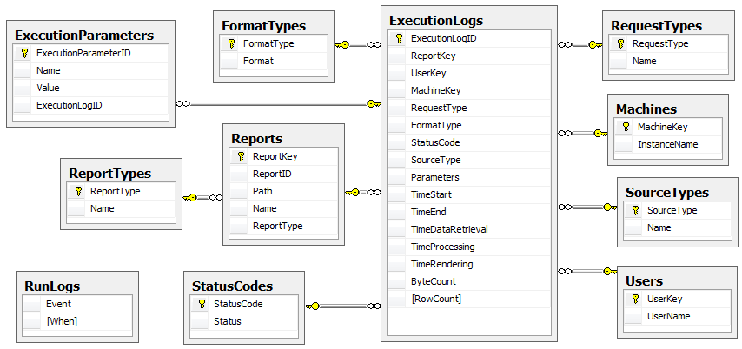
RSExecutionLog: Database Diagram

Slide 9
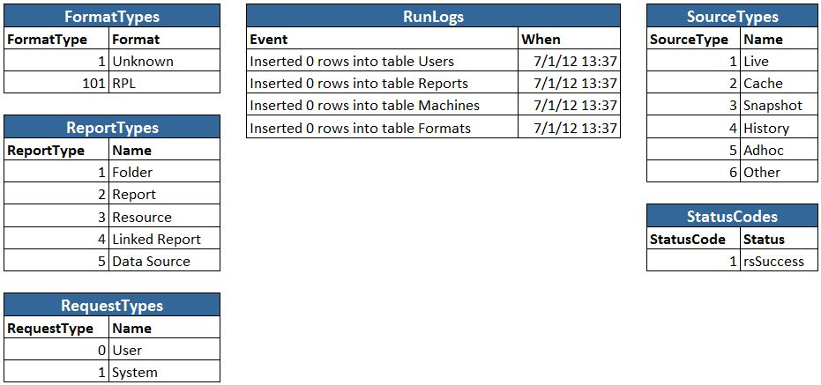
RSExecutionLog: Dimension Values

Slide 10

RSExecutionLog: SQL 2008 R2
Download not available for 2008 R2, but upgrade path has been documented by others: sqltwist.com/archives/197
Documentation not quite right (for my box), so providing download
  Scripts for objects
  SSIS Package

Slide 11
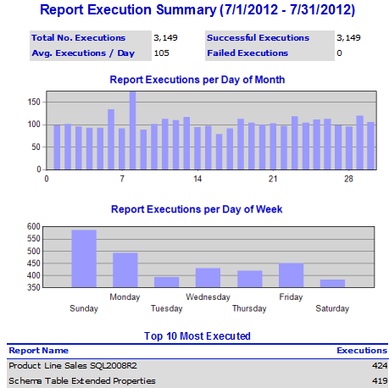
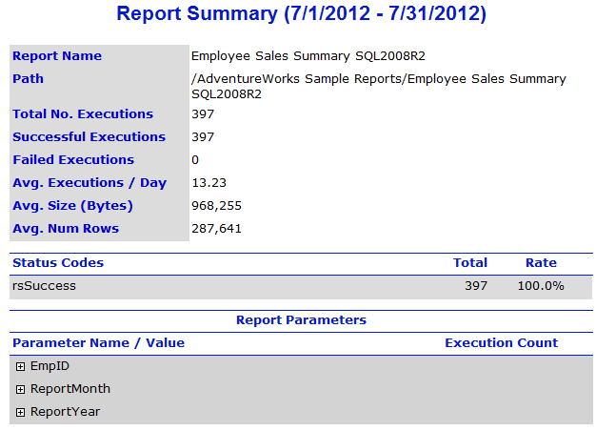
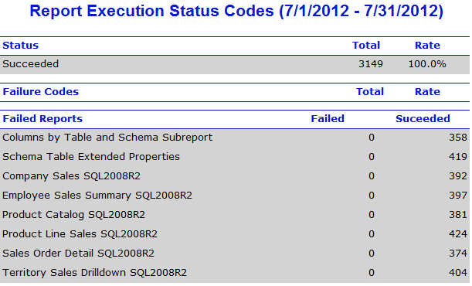
Reports: Canned Samples

Slide 12
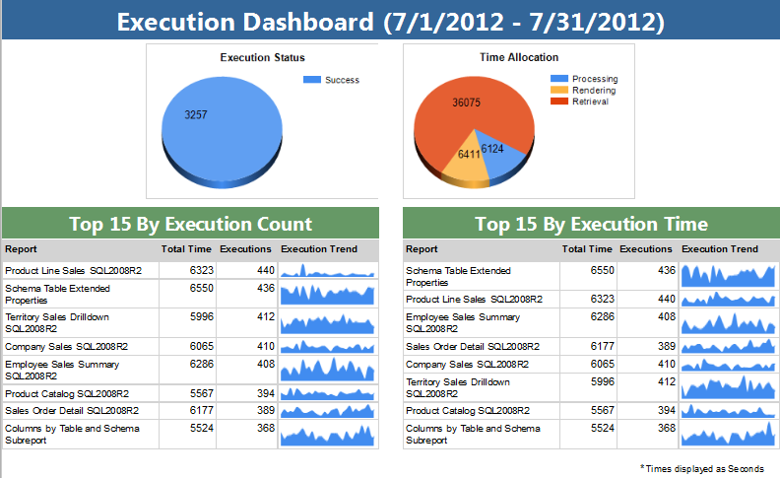
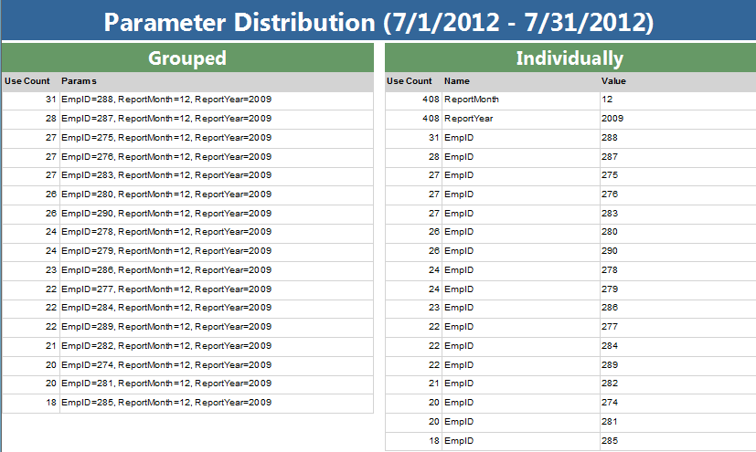
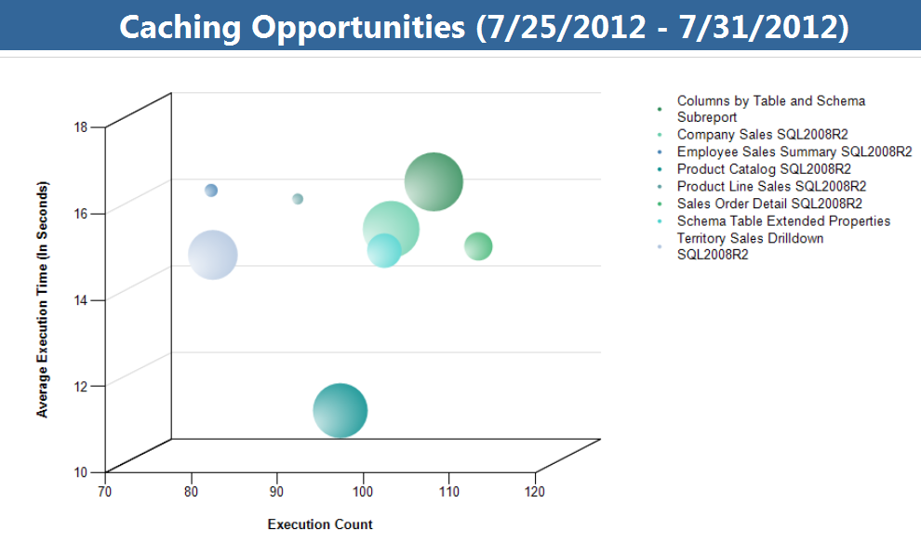
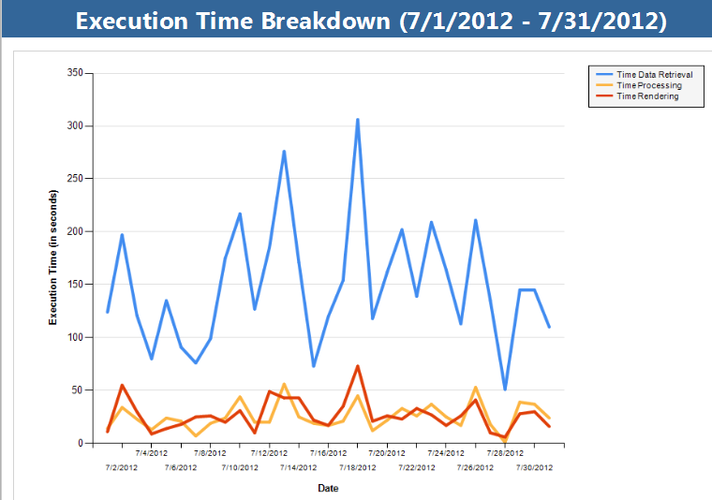
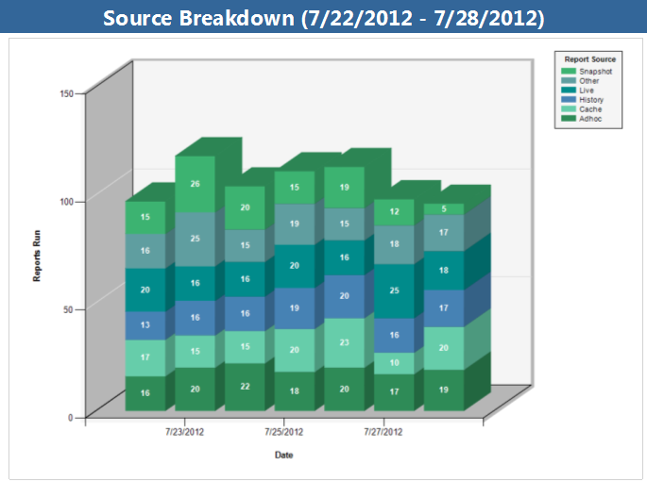
Reports: Eleven (bit.ly/9SPUYJ)

Slide 13
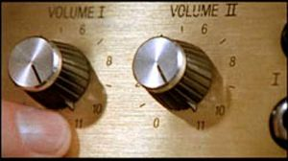
Wrap Up
ReportServerTempDB and ReportServer
RSExecutionLog
Eleven
  Five reports as of August 2012
  Eleven reports by December 2012
  SQL 2012 version by December 2012

Slide 14
Questions & Discussion
Rick Krueger
Twitter: @DataOgre
Blog: www.premierapps.com
Email: rick@premierapps.com
Dave Valentine
Twitter: @IngeniousSQL
Blog: www.IngeniousSQL.com
Email: Dave.Valentine@IngeniousSQL.com

